Slide 1
Chrono Timer
Group 1: SSJN
Sam, Shaun, Jess, Nate

Slide 2
Overview
Use Case
Domain Model
Sprint Designs and Challenges
Test Plan
Demonstration

Slide 3
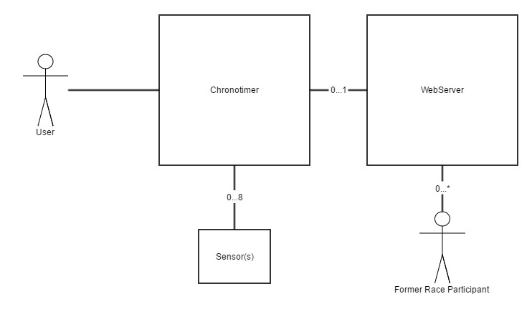
Use Case

Slide 4
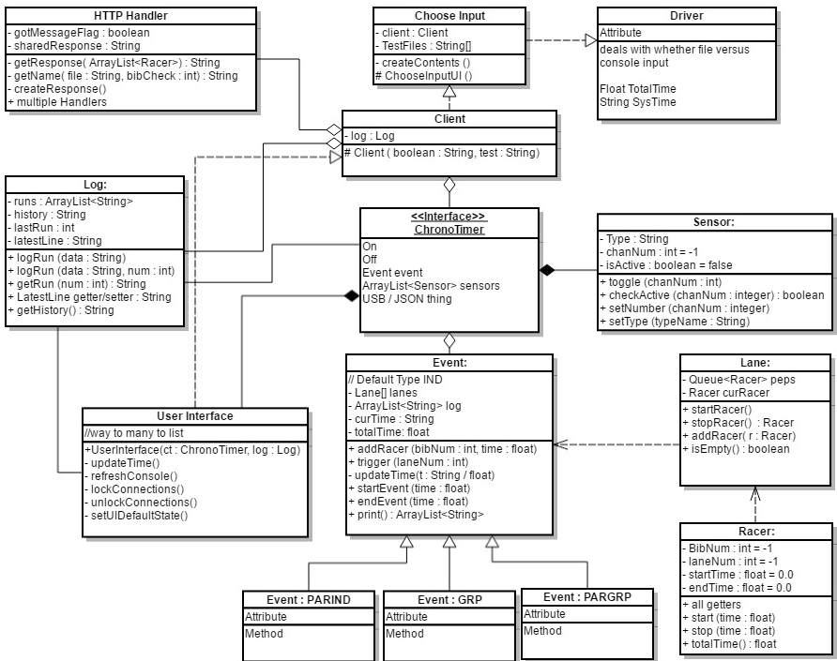
Domain Model

Slide 5
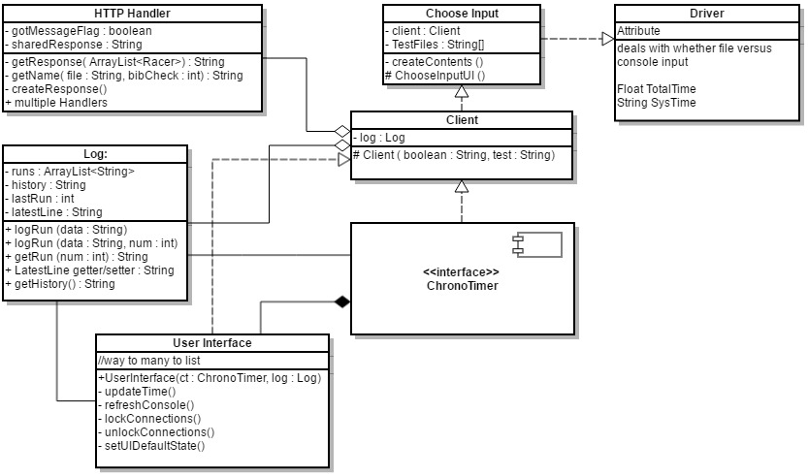
Zoomed In Domain

Slide 6
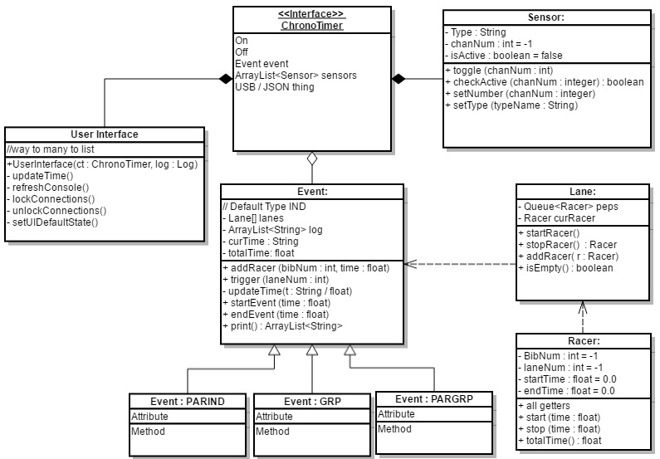
ChronoTimer Component

Slide 7
Initial Design: Sprint 1
Requirements: Basic functionality, IND race, IND special cases
Approach: Build skeleton of entire project
Challenges:
Scaled too large too fast
Confusion on purposes and interaction of different classes
Debate on which class had control/access/ownership of others

Slide 8
Rethinking Design: Sprint 2
Requirements: PARIND, USB export
Approach: Focused in fixing structure and only Sprint 2 updates
Challenges:
Clear domain model to reference
What went into Driver class and what stayed in the interface

Slide 9
Working Plan: Sprint 3
Requirements: GUI, GRP,
Approach: Divided members between GUI and functionality
Challenges:
Function menu in GUI
Sensor connect-disconnect

Slide 10
Adding Features: Sprint 4
Requirements: PARGRP, web server,
Approach: Continue working on previous section with new additions
Challenges:
Underestimated time requirements
Bug states

Slide 11
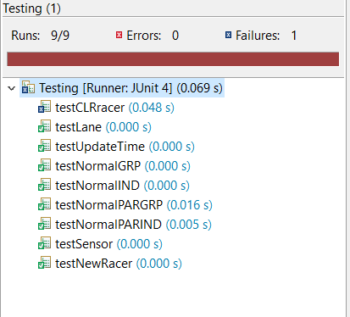
Test Plan
Class functionality
Each run
Unique cases

Slide 12
Demo
Each race type
Web server

Slide 13
Summary
Use Case
Domain Model
Sprint Designs and Challenges
Test Plan
Demonstration

